Slide 1


Gold Trade in Africa: A Data Science Study
A comprehensive analysis of gold trade dynamics between Burkina Faso, South Africa, and global partners from 2018-2024, with a focus on HS Code 7108 Series data.
Submitted to: Dr. Sami Ur Rahman Mr. Ebby George Varghese
Submitted by:
Data Science B: Group 8

Slide 2

Agenda
Insights
Analysis
Key Findings
Foundation
Data Cleaning
Geopolitical Factors
Problem Statement
Data Exploration
Recommendations
Tools & Methodology
Trend Analysis
Data Collection
Country Comparisons
Our analysis follows a structured approach, beginning with problem definition and data preparation, moving through detailed analysis, and concluding with actionable insights for economists and policymakers.

Slide 3

Problem Statement
Performance Assessment
Evaluating Burkina Faso and South Africa's comparative positions in global gold trade markets
Trade Partnerships
Analyzing complex trade dynamics between African gold exporters and G7/BRICS nations
Product Dominance
Identifying which gold subtypes (powder, unwrought, semi-manufactured) command market share
Event Impact
Measuring how global disruptions (COVID-19, geopolitical tensions) affected African gold exports

Slide 4
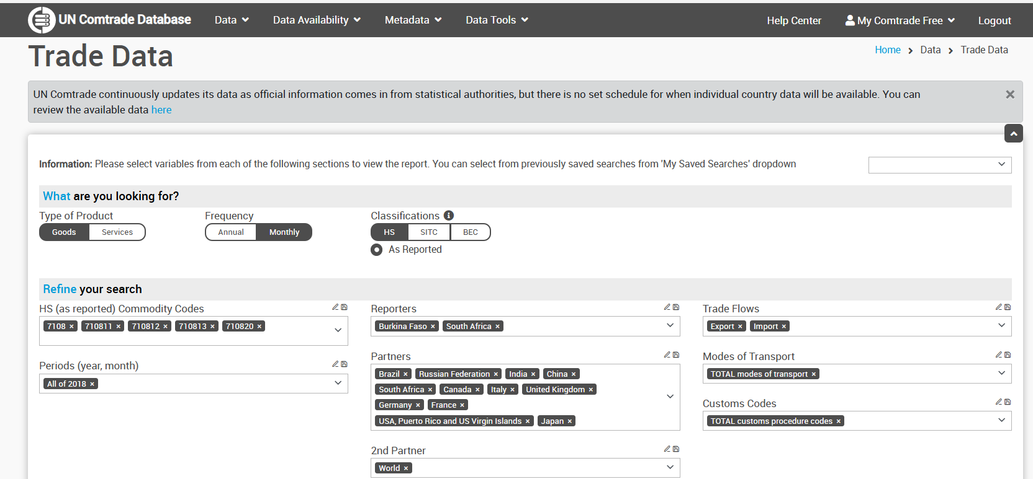

Data Sources & Classification
UN Comtrade
Partner countries analyzed include all G7 and BRICS nations to capture both traditional and emerging market relationships.

Slide 5




Data Preparation Methodology
Raw Data Acquisition
Data Integration
Exported comprehensive CSV datasets from UN Comtrade, segmented by country, year, and product code
Combined multiple datasets using country, year, and HS code as primary keys for consistent analysis
Partner Grouping
Metric Extraction
Classified trading partners into G7 and BRICS categories to identify economic bloc patterns
Isolated key variables: trade value (USD), quantity (kg), temporal indicators, and partner identifiers
The data preparation process eliminated inconsistencies while preserving the integrity of trade relationships, enabling robust statistical analysis.

Slide 6




Technical Toolkit
Microsoft Excel
Python Ecosystem
Preliminary data organization, filtering, and basic statistical functions
Pandas for data manipulation, NumPy for numerical operations, and specialized functions for complex transformations
Visualization Libraries
Power BI
Seaborn and Matplotlib for static visualizations, correlation matrices, and distribution analysis
Optional interactive dashboards for stakeholder exploration and dynamic filtering capabilities
Our toolkit combines industry-standard data science technologies optimized for trade data analysis, enabling both rigorous statistical examination and accessible visualization.

Slide 7
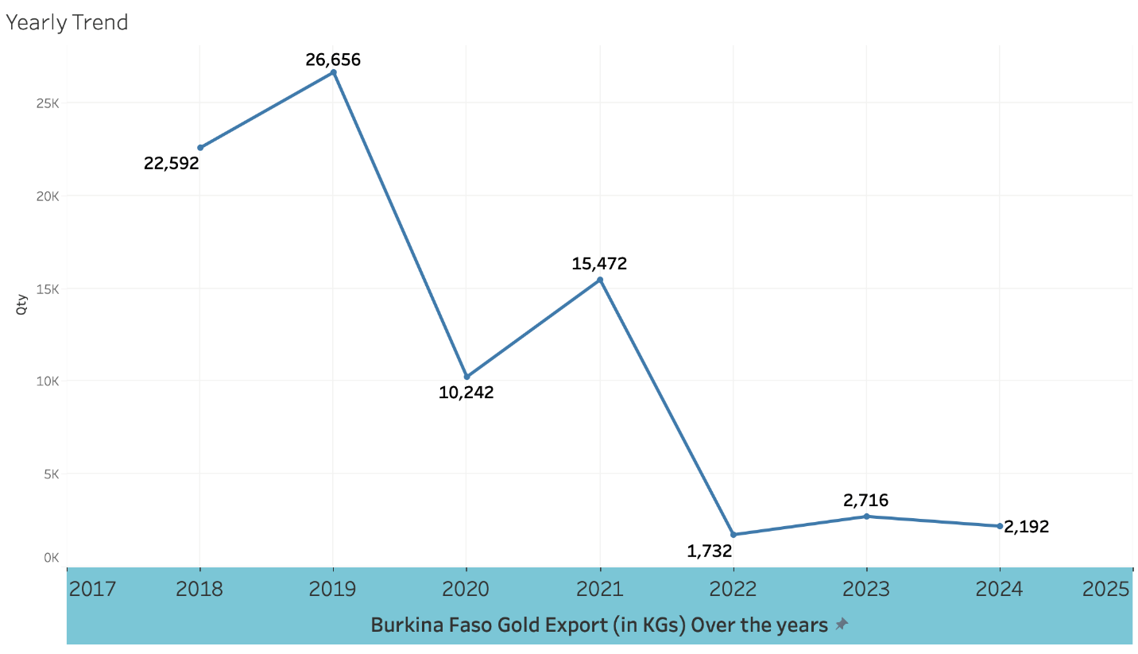
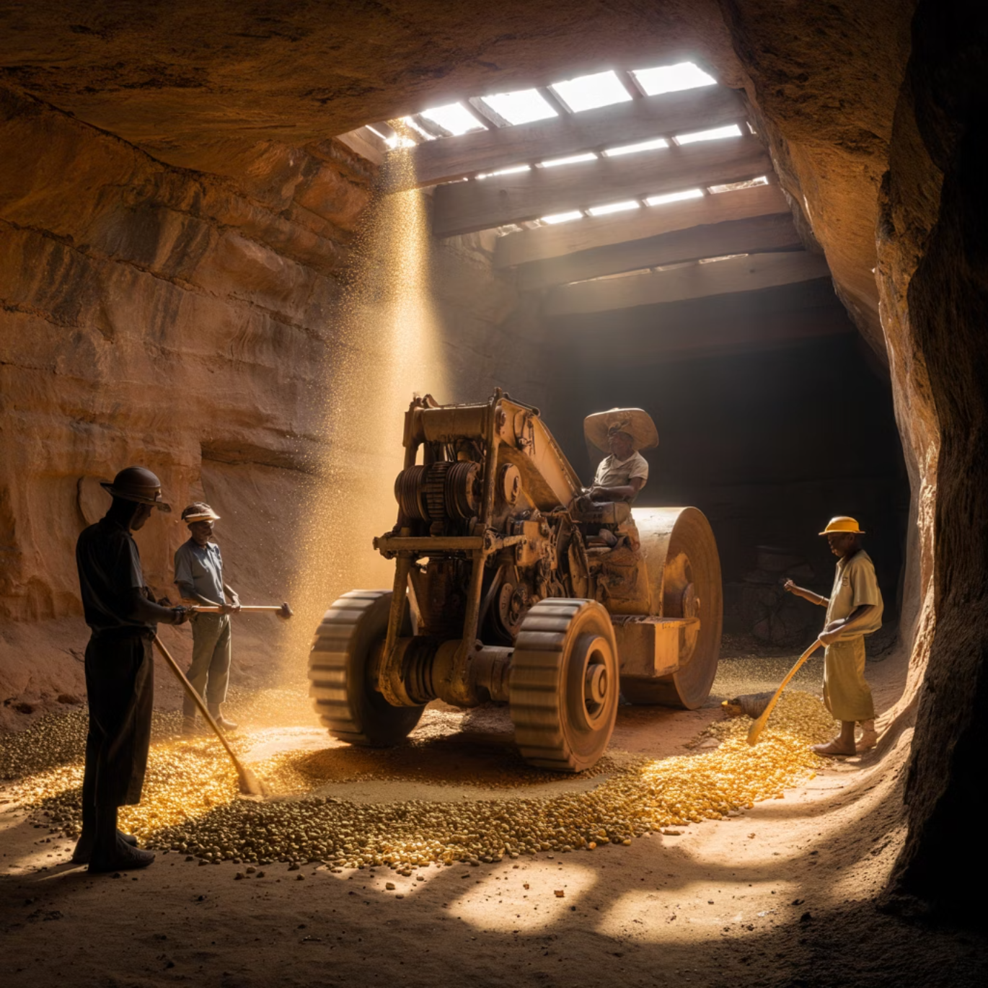
Burkina Faso Gold Export Analysis (2018-2024)
Key Observations
Significant export growth (107%) from 2018 to 2022
Dramatic spike in 2021-2022 during global supply chain disruptions
HS 710812 (unwrought gold) comprises 94% of exports
Recent decline possibly linked to security concerns and changing trade relationships

Slide 8
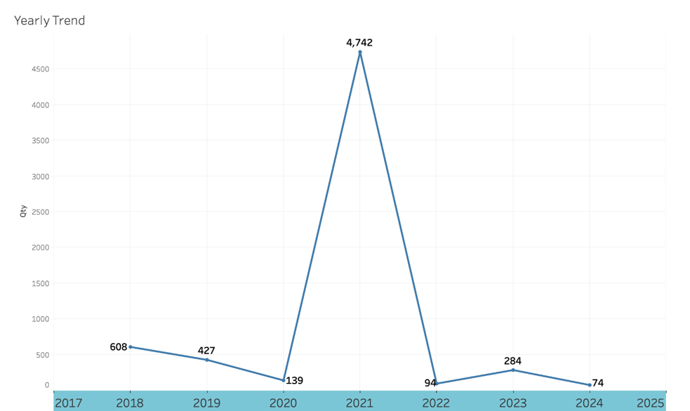

South Africa Gold Export Analysis (2018-2024)
Comparative Analysis
More stable export profile than Burkina Faso
Decline of 82.5% from 2019 peak to 2024
More diversified product mix: 62% HS 710812 (unwrought) and 37% HS 710813 (semi-manufactured)
Less volatile response to global events

Slide 9
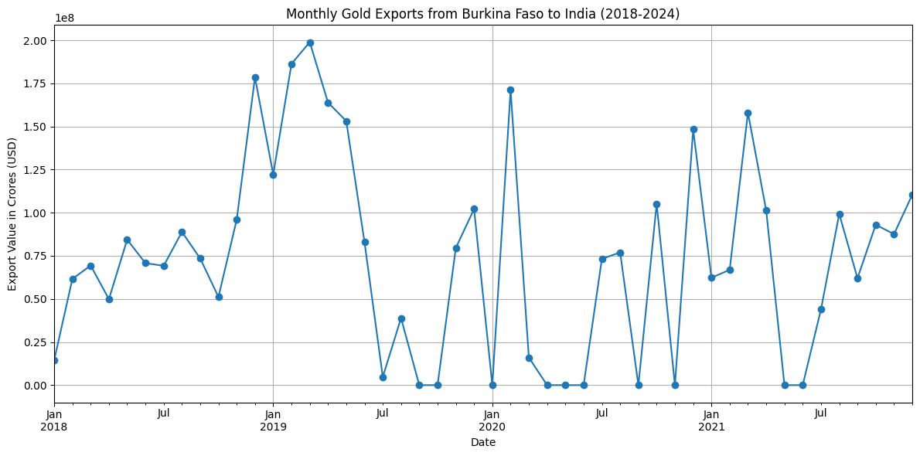

Combined Monthly Trend Analysis

Slide 10
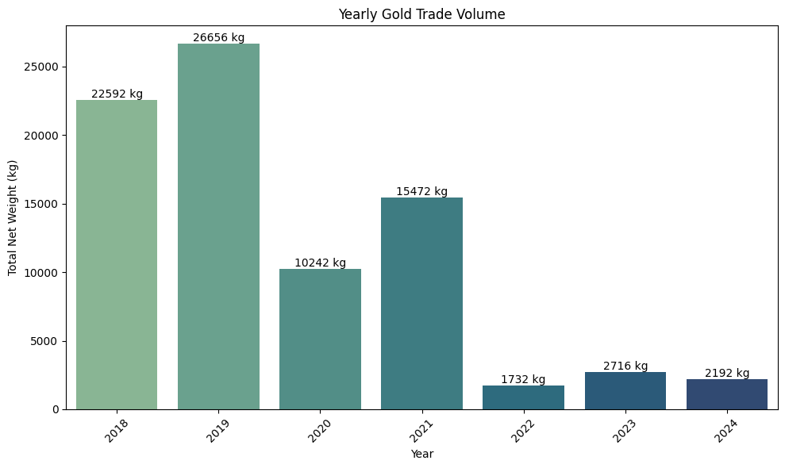

Trend Analysis of Burkina Faso
Q1 2020
1
Sharp decline in exports as COVID-19 disrupts global supply chains and mining operations
2
Q3-Q4 2020
Gradual recovery begins as mining operations adapt to pandemic protocols
Q2 2021
3
Strong rebound exceeding pre-pandemic levels as gold prices surge amid economic uncertainty
4
Q1 2022
Peak export volumes coincide with geopolitical tensions and inflation concerns
Q3 2022-2024
5
Gradual normalization with seasonal patterns becoming more pronounced

Slide 11
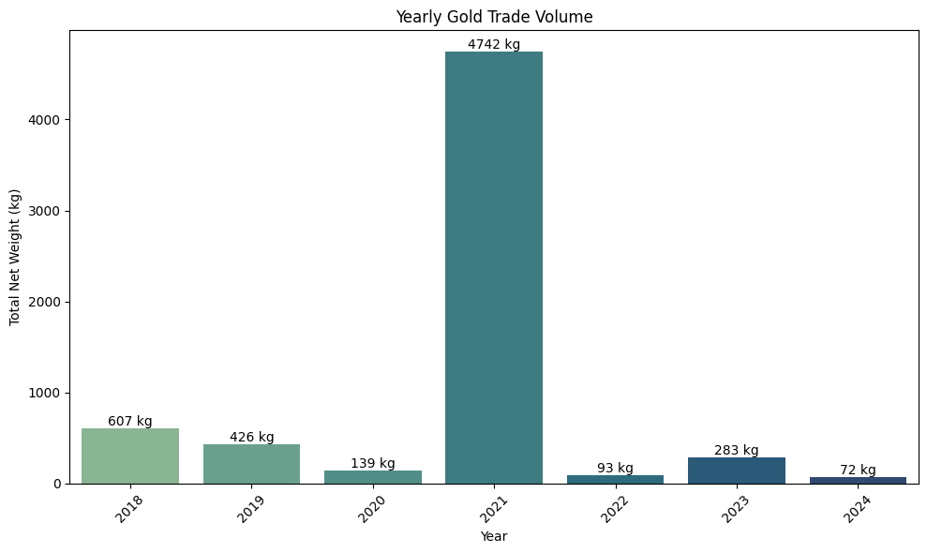

Trend Analysis of South Africa
Q1 2020
1
Sharp decline in exports as COVID-19 disrupts global supply chains and mining operations
2
Q3-Q4 2020
Gradual recovery begins as mining operations adapt to pandemic protocols
Q2 2021
3
Strong rebound exceeding pre-pandemic levels as gold prices surge amid economic uncertainty
4
Q1 2022
Peak export volumes coincide with geopolitical tensions and inflation concerns
Q3 2022-2024
5
Gradual normalization with seasonal patterns becoming more pronounced

Slide 12

Combined Monthly Trend Analysis
Q1 2020
1
Sharp decline in exports as COVID-19 disrupts global supply chains and mining operations
2
Q3-Q4 2020
Gradual recovery begins as mining operations adapt to pandemic protocols
Q2 2021
3
Strong rebound exceeding pre-pandemic levels as gold prices surge amid economic uncertainty
4
Q1 2022
Peak export volumes coincide with geopolitical tensions and inflation concerns
Q3 2022-2024
5
Gradual normalization with seasonal patterns becoming more pronounced

Slide 13

Key Findings & Recommendations
Critical Insights
Recommendations for Stakeholders
Burkina Faso shows higher growth potential but greater volatility compared to South Africa's stable but declining output
Invest in domestic refining capacity to capture more value from gold exports
Develop intra-African gold trade relationships to reduce dependency on external markets
G7 nations remain dominant trade partners, but BRICS share is growing (+18% since 2018)
Implement advanced analytics for early detection of market shifts
Diversify export markets to balance G7 and BRICS relationships
Unwrought gold (HS 710812) dominates exports, indicating limited value addition within Africa
Establish gold reserves as economic buffers against global volatility
Global disruptions trigger significant price and volume fluctuations, with African producers showing varying resilience
Follow-up research should explore artisanal mining impacts and emerging West African producers.

Slide 14
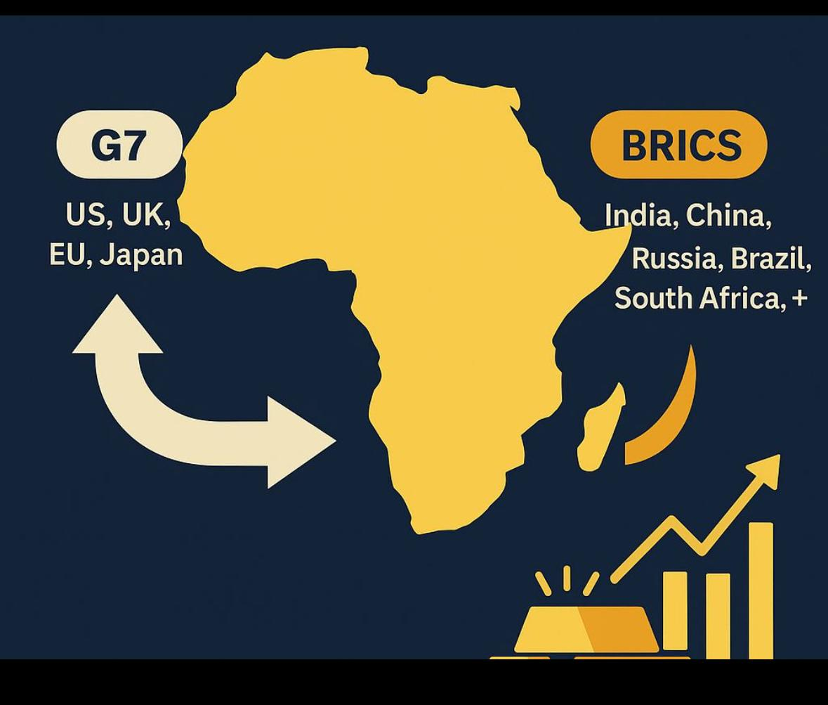
African Gold Trade: BRICS vs G7 Geopolitical Dynamics
This analysis explores gold trading patterns between African nations (focusing on Burkina Faso and South Africa) and major global powers, revealing shifting dynamics between BRICS and G7 nations with significant geopolitical implications.

Slide 15


Trade with BRICS
The BRICS nations, particularly India and China, have established themselves as dominant trading partners for African gold producers:
India has emerged as the primary importer of Burkina Faso's gold
China sources primarily from South Africa
Many transactions are routed through the UAE as an intermediary hub

Slide 16

Trade with G7
Key G7 Partners
South African Relationships
Burkina Faso Dynamics
The United Kingdom, United States, and Japan represent the primary G7 nations engaged in African gold trade
South Africa maintains established long-term trading relationships with G7 nations, built on historical ties and infrastructure
Burkina Faso has minimal direct trade with G7 countries, focusing instead on BRICS partnerships

Slide 17
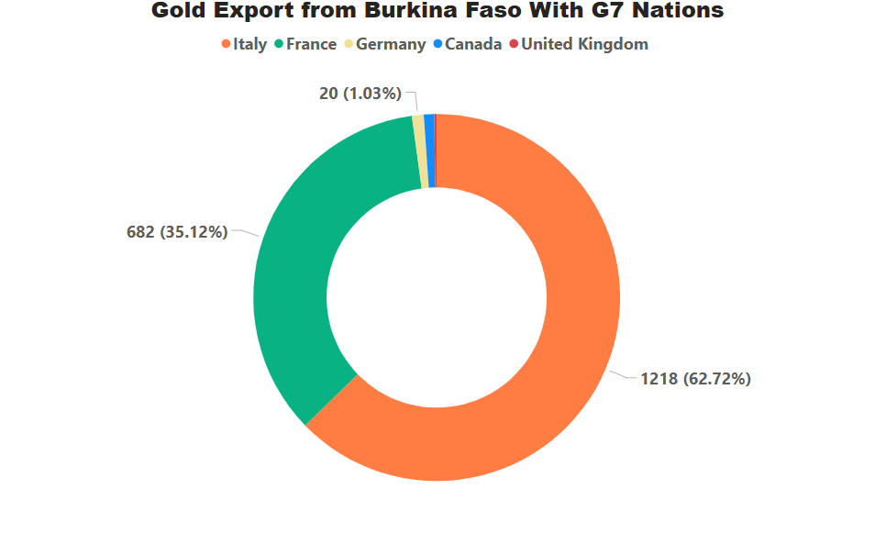
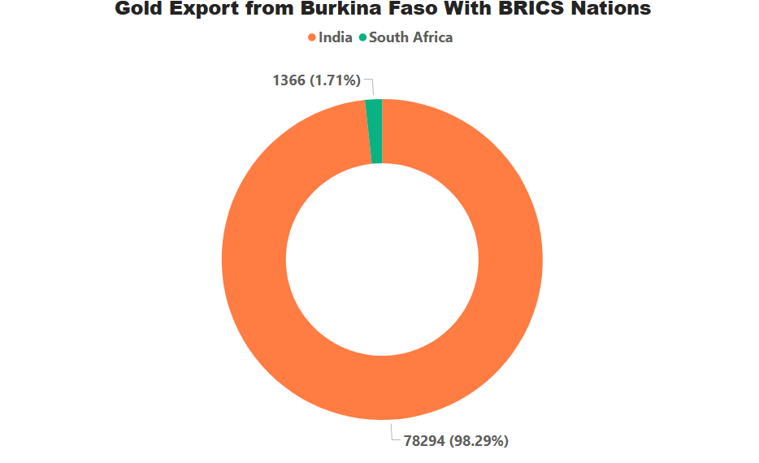

Partner Share Comparison
Burkina Faso
Burkina Faso shows a clear preference for BRICS trading partners, while South Africa maintains a more balanced distribution between BRICS and G7 nations.

Slide 18
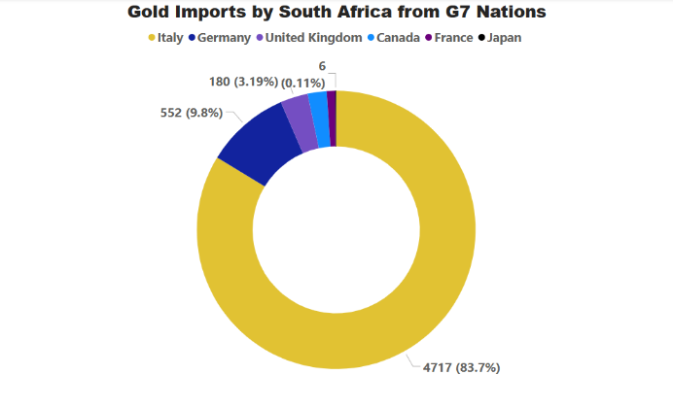
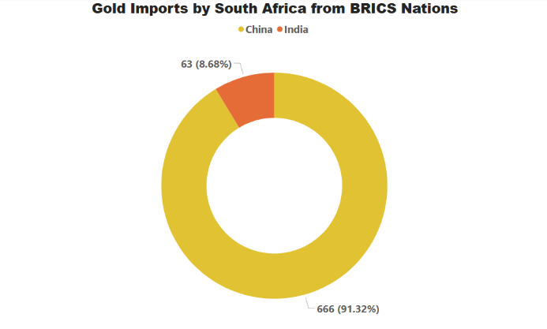

Partner Share Comparison
South Africa
Burkina Faso shows a clear preference for BRICS trading partners, while South Africa maintains a more balanced distribution between BRICS and G7 nations.

Slide 19
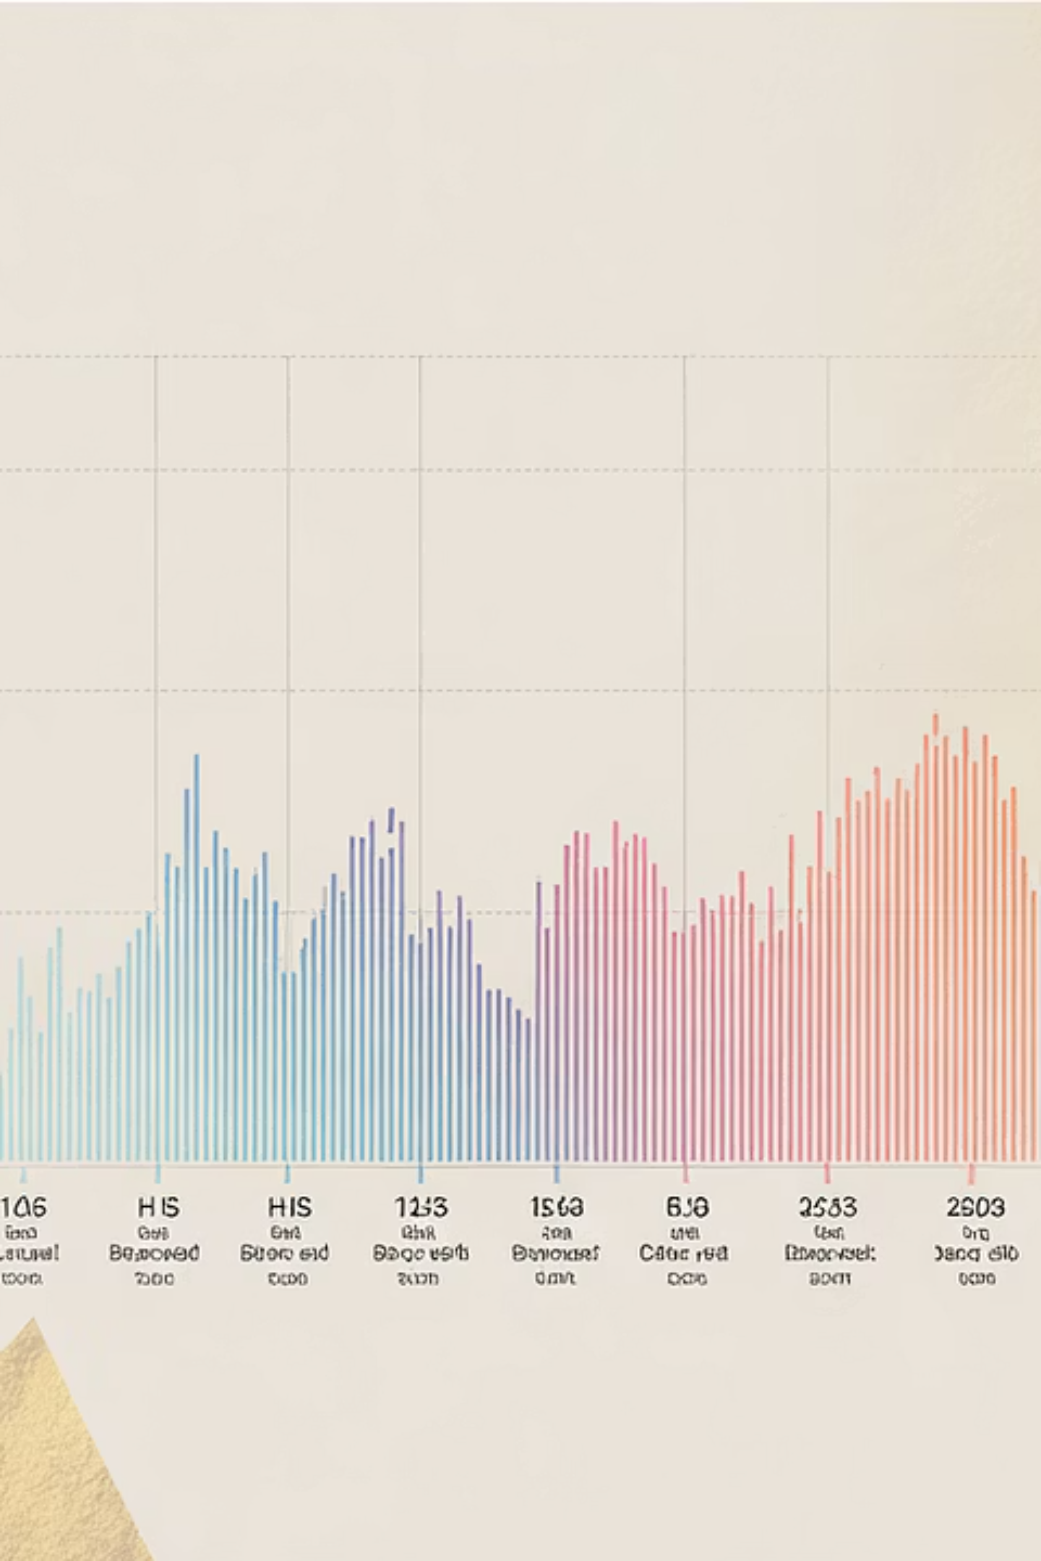
Heatmap: Year vs Quantity (HS Code Split)
The heatmap reveals Burkina Faso's strategic shift from exporting raw gold (HS code 710812) toward semi-processed gold products (HS code 710813), indicating potential development in local refining capabilities.

Slide 20



Correlation Matrix
Burkina Faso
South Africa
Implications
High positive correlation (>0.85) between export value, net weight, and global gold prices
Moderate correlation coefficients reflect greater supply chain resilience
Reveals vulnerability differences between established and emerging producers
Suggests high price sensitivity and limited market power
Indicates more sophisticated market positioning and negotiating power
Highlights opportunity for Burkina Faso to develop more resilient trade structures

Slide 21
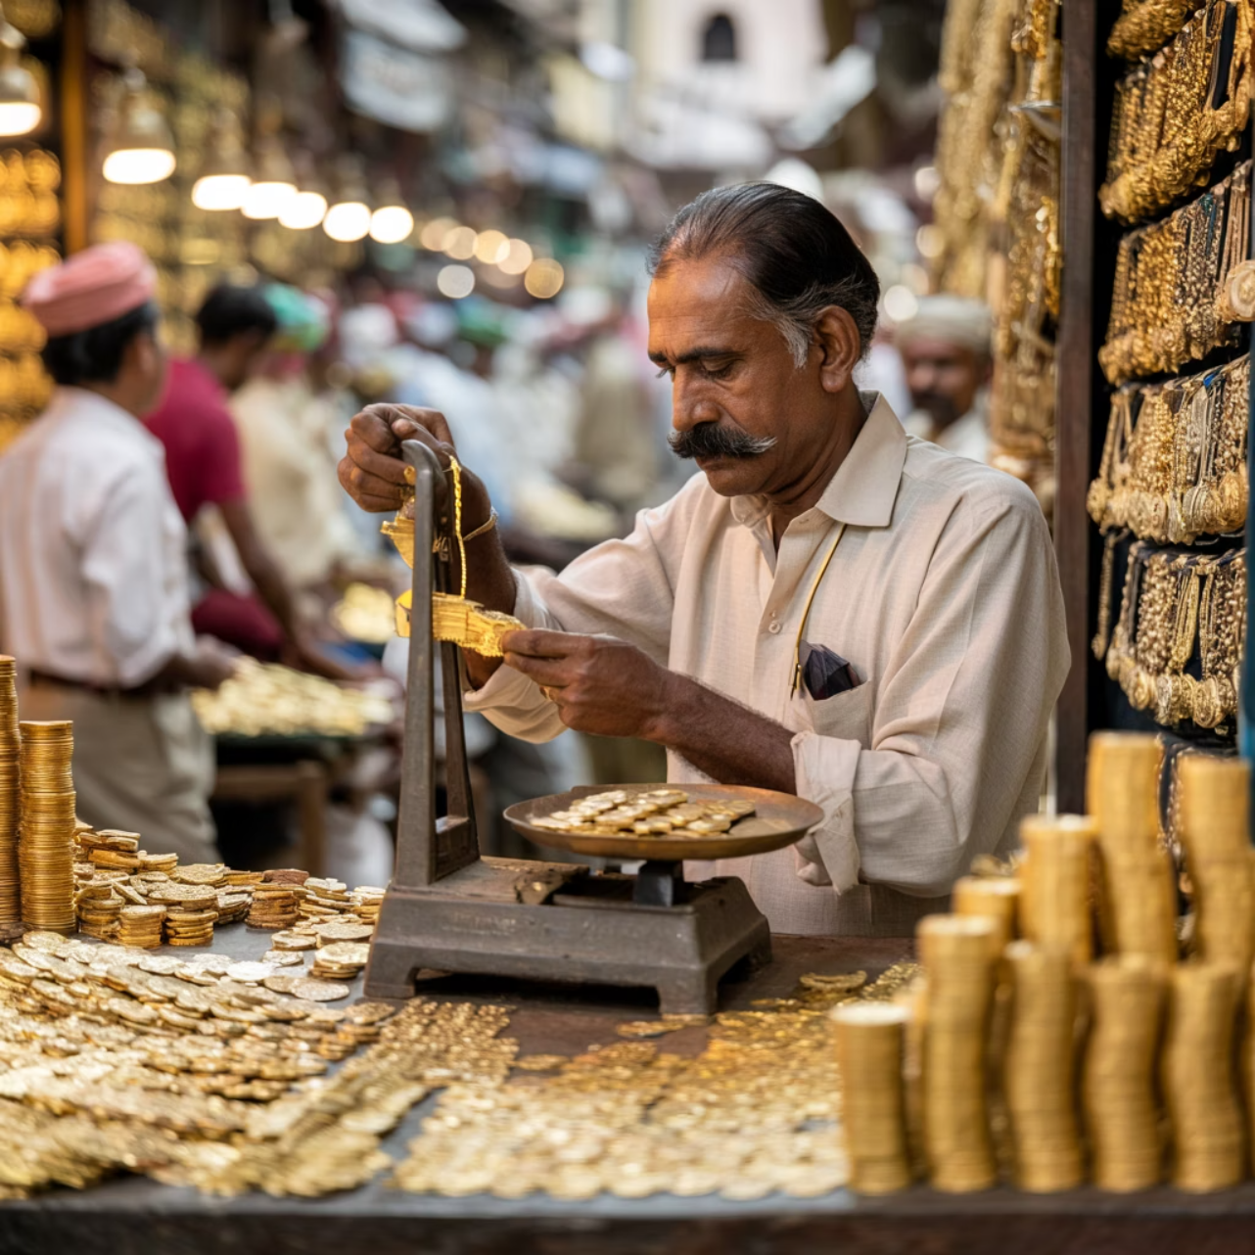

Geopolitical Insight: India
India's Gold Appetite
Imported 713 tonnes of gold in 2022 alone
22.7% sourced from African nations
Significant portion routed through UAE intermediaries
Major purchaser of raw gold (HS code 710812)
Driven by jewelry industry and investment demand

Slide 22


Geopolitical Insight: China
Market Share
Supply Chain
China accounts for approximately 10% of global imports of African gold, establishing a significant foothold in the continent
Officially declares South Africa as primary source, but actual routing patterns suggest complex supply networks
Transparency Issues
Low transparency in transshipment data creates challenges in tracking exact volumes and origins

Slide 23

Geopolitical Insight: Russia & Wagner Group
Shadow Operations
Market Impact
The Wagner Group has established significant presence in:
These undeclared exports create:
Central African Republic
Statistical discrepancies in trade data
Sudan
Price distortions in regional markets
Mali
Financing for non-state military operations
Challenges for legitimate market participants
Intelligence reports suggest control over 30-50 tonnes of gold annually through alleged smuggling operations

Slide 24

Key Findings & Recommendations
Current State
Burkina Faso emerging as major raw gold exporter
South Africa shifting toward semi-finished exports
BRICS overtaking G7 in African gold trade
Significant reporting discrepancies between declared and received volumes
1
2
Recommendations
Track high-risk trade routes via UAE
Encourage local refining to increase HS 710813 exports
Strengthen data reporting mechanisms
Develop policy dashboards using exploratory data analysis
Implement transparent trade tools and regulatory checks

Slide 25



Conclusion
Gold Sector Outlook: Burkina Faso & South Africa
Burkina Faso
South Africa
Opportunities & challenges ahead. Strategic reforms vital for long-term viability. Transition to BRICS/Middle Eastern partnerships opens new markets.
Importer & processor, partners with China, Germany, Italy. Focus on specialised industrial applications.
2024 data gaps raise concerns. Addressing data quality & exploring regional processing crucial. Maintain robust trade monitoring.
Priorities: enhance domestic refining, bolster security, invest in energy. Goal: sustainable economic growth from gold.

